Slide 1
To structure or not to structure, is that the question?
Paolo Atzeni
Based on work done with (or by!)
G. Mecca, P.Merialdo, P. Papotti, and many others
Barcelona, 18 January 2011

Slide 2
Content
A personal (and questionable …) perspective on the role structure (and its discovery) has in the Web, especially as a replacement for semantics
Two observations
Especially important if we want automatic processing
Something similar happened for databases many years ago
and a disclaimer:
Personal means that I will refer to projects in my group (with some contradiction, as I have been personally involved only in some of them…)
Based on a talk given at the USETIM (Using Search Engine Technology for Information Management) worskhop in September 2009

Slide 3
Content
Questions on the Web
Structures in the Web, transformations: Araneus
Information extraction, wrappers: Minerva, RoadRunner
Crawling, extraction and integration: Flint

Slide 4
Web and Databases (1)
The Web is browsed and searched
Usually one page or one item at the time (may be a ranked list)
Databases are (mainly) queried
We are often interested in tables as results

Slide 5
What do we do with the Web?
Everything!
We often search for specific items, and search engines are ok
In other cases we need more complex things:
What could be the reason for which Frederic Joliot-Curie (a French physicist and Nobel laureate, son in law of P. and M. Curie) is popular in Bulgaria (for example, the International House of Scientists in Varna is named after him)?
Find a list of qualified database researchers who have never been in the VLDB PC and deserve to belong to the next one
I will not provide solutions to these problems, but give hints
Semantics
Structure

Slide 6
Questions on the Web: classification criteria (MOSES European project, FP5)
Format of the response
Involved sites: number (one or more) and relationship (of the same organization or not)
Structure of the source information
Extraction process

Slide 7
Format of the response
A simple piece of data
A web page (or fragment of it)
A tuple of data
A "concept"
A set or list of one of the above
Natural language (i.e., an explanation)

Slide 8
Involved sites
One or more
Of the same organization or not
Sometimes also sites and local databases

Slide 9
Structure of the source information
Information directly provided by the site(s) as a whole
Information available in the sites and correlated but not aggregated
Information available in the site in a unrelated way

Slide 10
Extraction process
Explicit service: this the case for example if the site offers an address book or a search facility for finding professors
One-way navigation: here the user has to navigate, but without the need for going back and forth (no “trial and error”)
Navigation with backtracking

Slide 11
Content
Questions on the Web
Structures in the Web, transformations: Araneus
Information extraction, wrappers: Minerva, RoadRunner
Crawling, extraction and integration: Flint

Slide 12
Web and Databases (2)
The answer to some questions requires structure (we need to "compile" tables)
databases are structured and organized
how much structure and organization is there in the Web?

Slide 13
Workshop on Semistructured Data at Sigmod 1997

Slide 14
Workshop on Semistructured Data at Sigmod 1997 - 2

Slide 15
Workshop on Semistructured Data at Sigmod 1997 - 3

Slide 16
Transformations
bottom-up: accessing information from Web sources
top-down: designing and maintaining Web sites
global: integrating existing sites and offering the information through new ones

Slide 17
The Araneus Project
At Università Roma Tre & Università della Basilicata 1996-2003
Goals: extend database-like techniques to Web data management
Several prototype systems

Slide 18
Example Applications
The Integrated Web Museum a site integrating data coming from the Uffizi, Louvre and Capodimonte Web sites
The ACM Sigmod Record XML Version XML+XSL Version of an existing (and currently running) Web site

Slide 19
The Integrated Web Museum
A new site with data coming from the Web sites of various museums
Uffizi, Louvre and Capodimonte

Slide 20
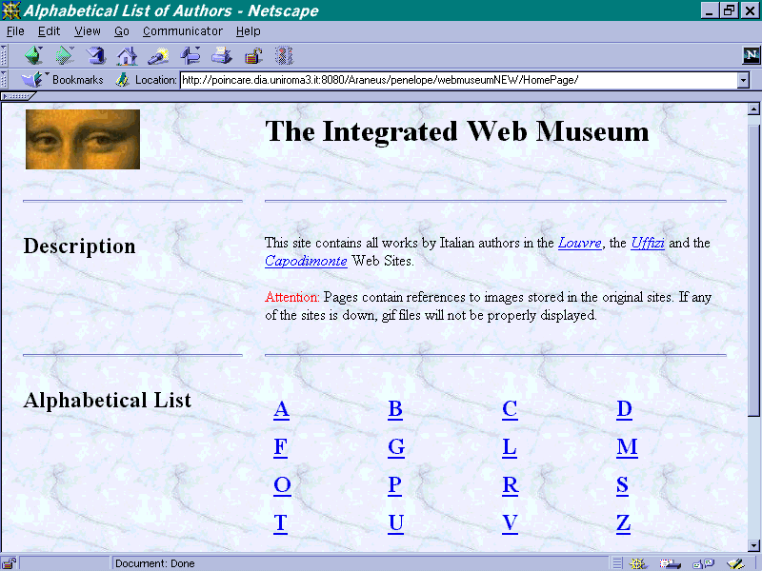
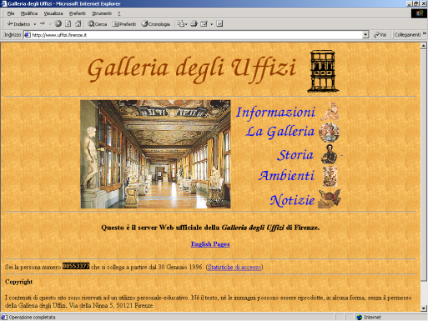
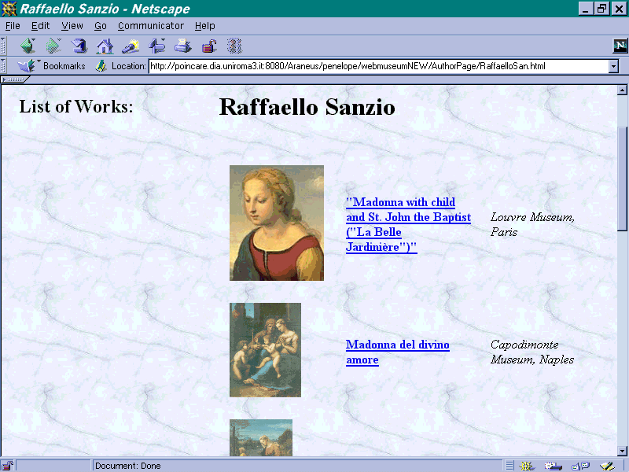
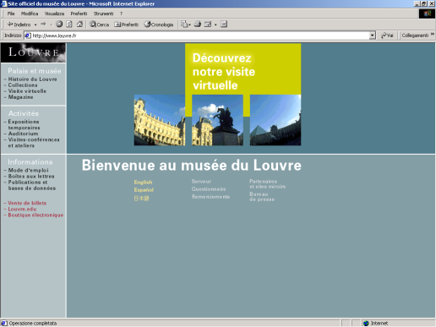
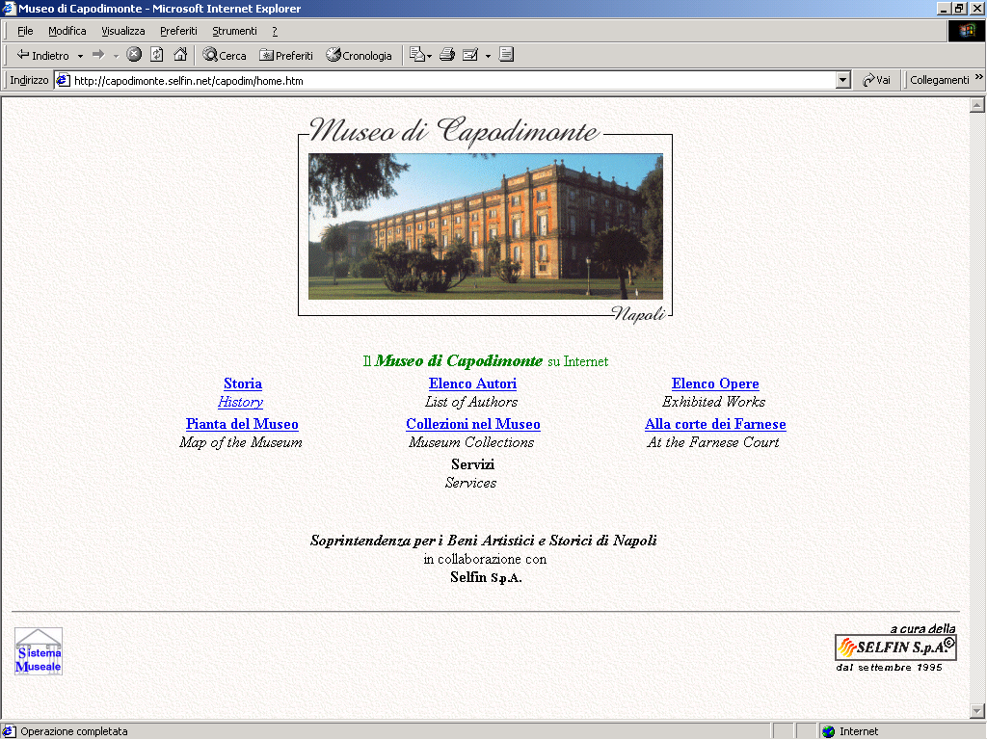
The Integrated Web Museum
DB

Slide 21
Integration of Web Sites: The Integrated Web Museum
Data are re-organized:
Uffizi, paintings organized by rooms
Louvre, Capodimonte, works organized by collections
Integrated Museum, organized by author

Slide 22
Web Site Re-Engineering: ACM Sigmod Record in XML
The ACM Sigmod Record Site (acm.org/sigmod/record)
an existing site in HTML
The ACM Sigmod Record Site, XML Edition
a new site in XML with XSL Stylesheets

Slide 23
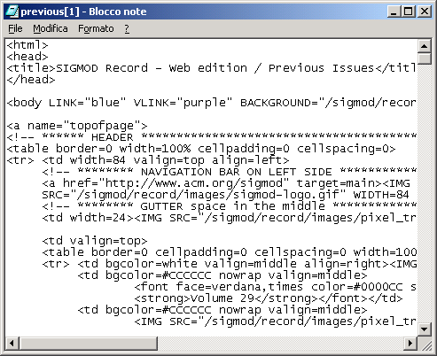
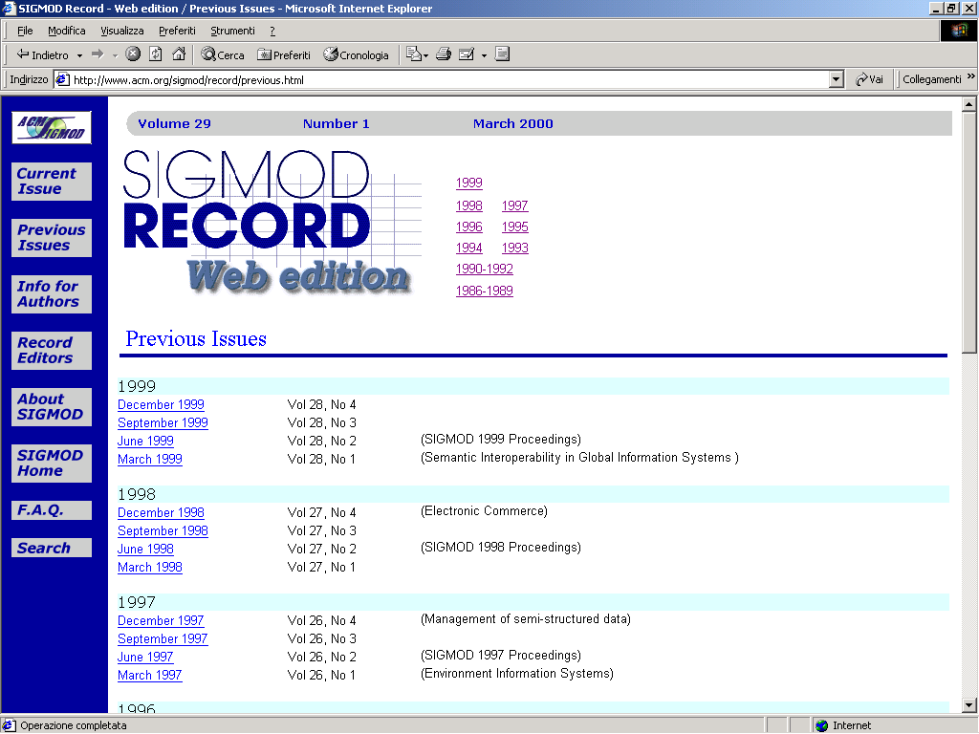

Slide 24
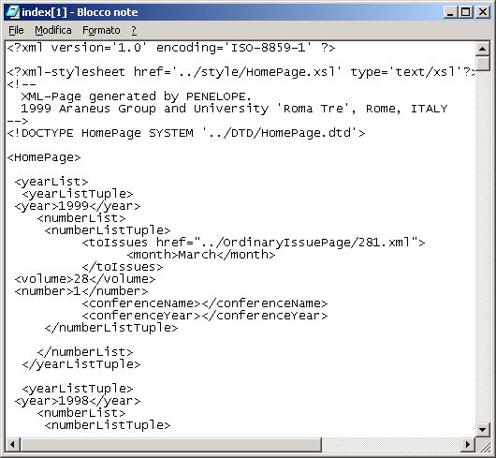
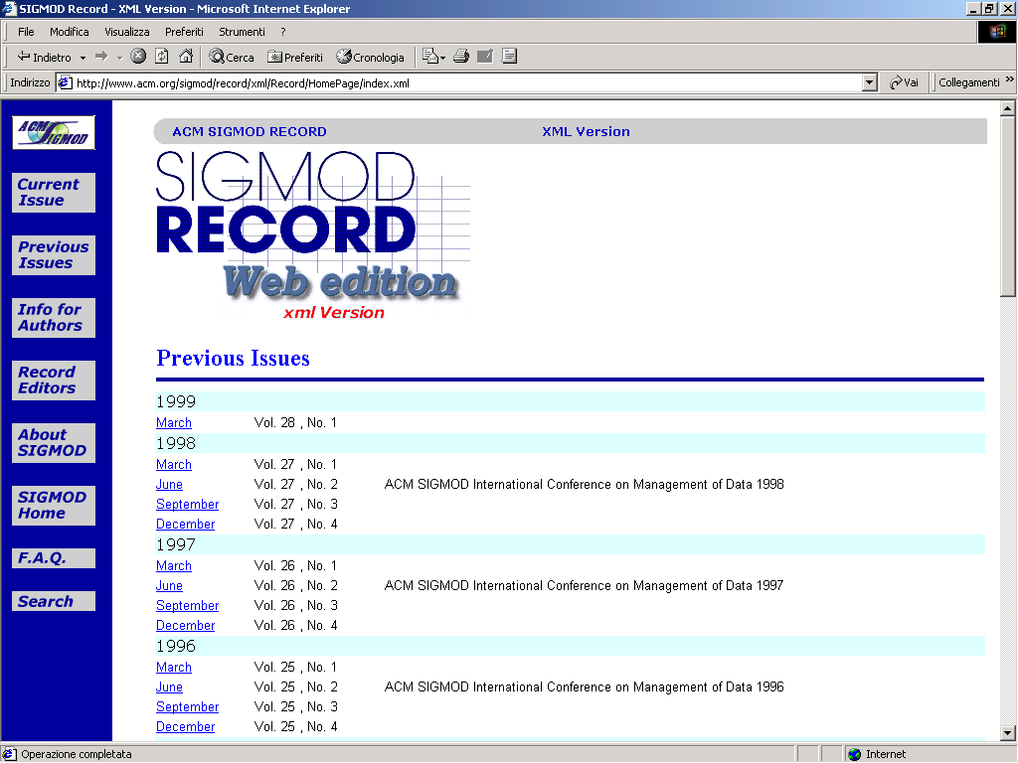
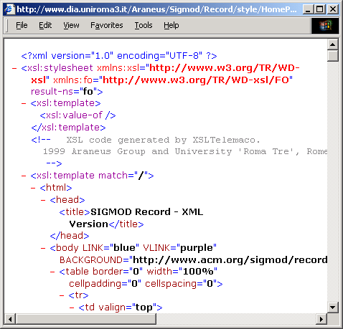

Slide 25
The Araneus Approach
Identification of sites of interest
Site Generation Layer
Araneus Web Site
Development System
(Homer)
Wrapping of sites to extract information
Navigation of site ad extraction of data
Integration Layer
SQL and Java
Integration of data
Araneus Query
System (Ulixes)
Generation of new sites
Mediator Layer
Wrapper
Layer
Wrapper
Layer
Wrapper
Layer
Wrapper
Layer
Araneus Wrapper Toolkit (Minerva)

Slide 26
Building Applications in Araneus
Phase A: Reverse Engineering Existing Sites
Phase B: Data Integration
Phase C: Developing New Integrated Sites

Slide 27
Building Applications in Araneus Phase A: Reverse Engineering
First Step: Deriving the logical structure of data in the site → ADM Scheme
Second Step: Wrapping pages in order to map physical HTML sources to database objects
Third Step: Extracting Data from the Site by Queries and Navigation

Slide 28
Content
Questions on the Web
Structures in the Web, transformations: Araneus
Information extraction, wrappers: Minerva, RoadRunner
Crawling, extraction and integration: Flint

Slide 29
Information Extraction Task
Information extraction task
source format: plain text with HTML markup (no semantics)
target format: database table or XML file (adding structure, i.e., “semantics”)
extraction step: parse the HTML and return data items in the target format
“Wrapper”
piece of software designed to perform the extraction step

Slide 30
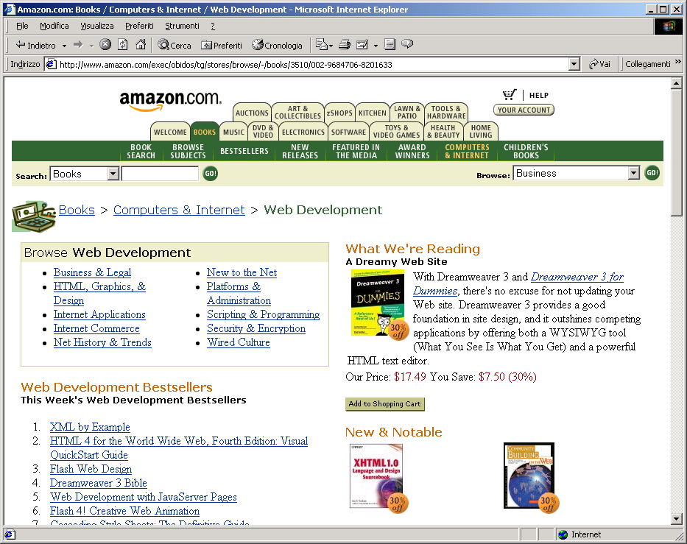
Notion of Wrapper
BookTitle
Author
Editor
The HTML Sourcebook
J. Graham
...
Computer Networks
A. Tannenbaum
...
Database Systems
R. Elmasri, S. Navathe
...
Wrapper
Data on the Web
S. Abiteboul, P.Buneman, D.Suciu
…
database table(s) (or XML docs)
HTML page
Intuition:
use extraction rules based on HTML markup

Slide 31
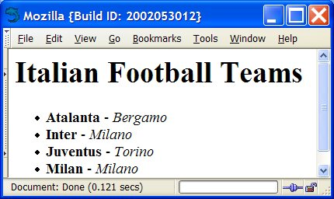
Intuition Behind Extraction
teamName | town
Atalanta | Bergamo
Inter | Milano
Juventus | Torino
Milan | Milano
… | …
<html><body>
<h1>Italian Football Teams</h1>
<ul>
<li><b>Atalanta</b> - <i>Bergamo</i> <br>
<li><b>Inter</b> - <i>Milano</i> <br>
<li><b>Juventus</b> - <i>Torino</i> <br>
<li><b>Milan</b> - <i>Milano</i> <br>
</ul>
</body></html>
Wrapper Procedure:
Scan document for <ul>
While there are more occurrences
scan until <b>
extract teamName between <b> and </b>
scan until <i>
extract town between <i> and </i>
output [teamName, town]

Slide 32
The Araneus Wrapper Toolkit
Procedural Languages
Grammars
Flexible in presence of irregularities and exceptions
Allows document restructurings
Concise and declarative
Simple in the case of strong regularity
Advantages
Tedious even with document strongly structured
Difficult to maintain
Not flexible in presence of irregularities
Allow for limited restructurings
Drawbacks

Slide 33
The Araneus Wrapper Toolkit: Minerva + Editor
Minerva is a Wrapper generator
It couples a declarative, grammar-based approach with the flexibility of procedural programming:
grammar-based
procedural exception handling

Slide 34
Development of wrappers
Effective tools: drag and drop, example based, flexible
Learning and automation (or semiautomation)
Maintenance support:
Web sites change quite frequently
Minor changes may disrupt the extraction rules
maintaining a wrapper is very costly
this has motivated the study of (semi)- automatic wrapper generation techniques

Slide 35
Observation
Can XML or the Semantic Web help much? Probably not
the Web is a giant “legacy system” and many sites will never move to the new technology (we said this ten years ago and it still seems correct …)
many organizations will not be willing to expose their data in XML

Slide 36
A related topic: Grammar Inference
The problem
given a collection of sample strings, find the language they belong to
The computational model: identification in the limit [Gold, 1967]
a learner is presented successively with a larger and larger corpus of examples
it simultaneously makes a sequence of guesses about the language to learn
if the sequence eventually converges, the inference is correct

Slide 37
The RoadRunner Approach
RoadRunner
[Crescenzi, Mecca, Merialdo 2001] a research project on information extraction from Web sites
The goal
developing fully automatic, unsupervised wrapper induction techniques
Contributions
wrapper induction based on grammar inference techniques (suitably adapted)

Slide 38
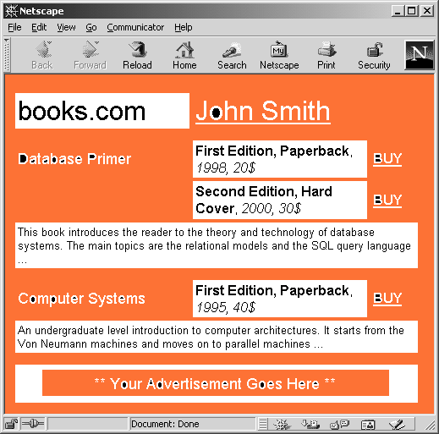
The Schema Finding Problem
A
B
C
D
E
F
G
H
Wrapper Output
John Smith
Database Primer
This book …
First Edition, …
1998
20$
Input HTML Sources
Second Edition, …
2000
30$
<HTML><BODY><TABLE>
<TR>
<TD><FONT>books.com<FONT></TD>
<TD><A>John Smith</A></TD>
</TR>
<TR>
<TD><FONT>Database Primer<FONT></TD>
<TD><B>First Edition, Paperback</B></TD>,
…
<HTML><BODY><TABLE>
<TR>
<TD><FONT>books.com<FONT></TD>
<TD><A>Paul Jones</A></TD>
</TR>
<TR>
<TD><FONT>XML at Work<FONT></TD>
<TD><B>First Edition, Paperback</B></TD>,
…
Computer Systems
An undergraduate …
First Edition, …
1995
40$
Paul Jones
XML at Work
A comprehensive …
First Edition, …
1999
30$
HTML and Scripts
An useful HTML …
null
1993
30$
Second Edition, …
1999
45$
JavaScripts
A must in …
null
2000
50$
…
…
…
…
…
…
Wrapper
Target Schema
<HTML><BODY><TABLE>
<TR>
<TD><FONT>books.com<FONT></TD>
<TD><A> #PCDATA</A></TD></TR>
(<TR>
( <TD><FONT> #PCDATA <FONT></TD>
( <TD><B> #PCDATA </B> )? </TD>
( <TR><TD><FONT> #PCDATA <FONT>
<B> #PCDATA </B> </TD></TR> )+
)+…
SET (
TUPLE (A : #PCDATA;
B : SET (
TUPLE ( C : #PCDATA;
D : #PCDATA;
E : SET (
TUPLE ( F: #PCDATA;
G: #PCDATA;
H: #PCDATA)))

Slide 39
The Schema Finding Problem
Page class
collection of pages generated by the same script from a common dataset
these pages typically share a common structure
Schema finding problem
given a set of sample HTML pages belonging to the same class, automatically recover the source dataset
i.e., generate a wrapper capable of extracting the source dataset from the HTML code

Slide 40
The RoadRunner Approach
The target
large Web sites with HTML pages generated by programs (scripts) based on the content of an underlying data store
the data store is usually a relational database
The process
data are extracted from the relational tables and possibly joined and nested
the resulting dataset is exported in HTML format by attaching tags to values

Slide 41
Contributions of RoadRunner
An unsupervised learning algorithm for identifying prefix-markup languages in the limit
given a rich sample of HTML pages, the algorithm correctly identifies the language
the algorithm runs in polynomial time
from the language, when can infer the underlying schema
and then extract the source dataset

Slide 42
Content
Questions on the Web
Structures in the Web, transformations: Araneus
Information extraction, wrappers: Minerva, RoadRunner
Crawling, extraction and integration: Flint

Slide 43
Data Extraction and Integration from Imprecise Web Sources
Lorenzo Blanco, Mirko Bronzi, Valter Crescenzi,
Paolo Merialdo, Paolo Papotti
Università degli Studi Roma Tre

Slide 44
Flint
A novel approach for the automatic extraction and integration of web data
Flint aims at exploiting an unexplored publishing pattern that frequently occurs in data intensive web sites:
large amounts of data are usually offered by pages that encode one flat tuple for each page
for many disparate real world entities (e.g. stock quotes, people, travel packages, movies, books, etc) there are hundreds of web sites that deliver their data following this publishing strategy
These collections of pages can be though as HTML encodings of a relation (e.g. "stock quote" relation)

Slide 45
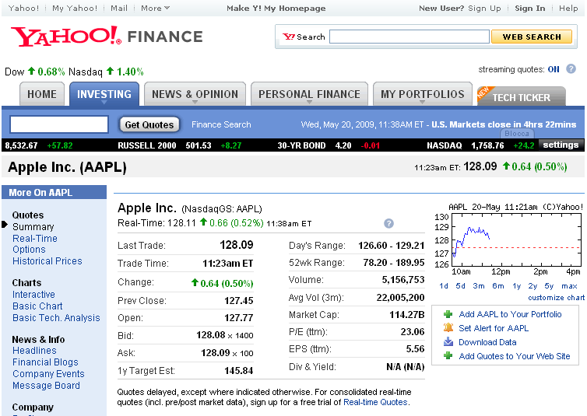
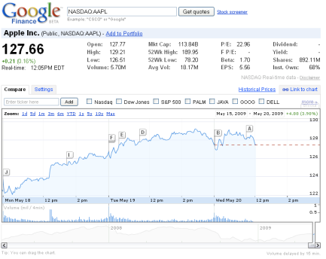
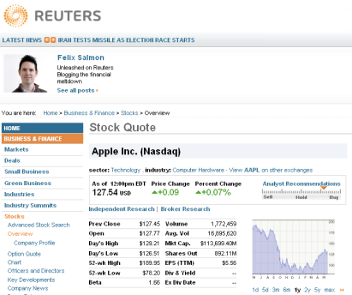
Example
…

Slide 46
Flint goals
Last
Min
Max
StockQuote
…
Volume
52high
Open

Slide 47
Flint goals
q₁
Q
Last
Min
Max
q₂
StockQuote
…
Volume
52high
Open
q_{n}

Slide 48
Extraction and Integration
Flint builds on the observation that although structured information is spread across a myriad of sources, the web scale implies a relevant redundancy, which is apparent
at the intensional level: many sources share a core set of attributes
at the extensional level: many instances occur in a number of sources
The extraction and integration algorithm takes advantage of the coupling of the wrapper inference and the data integration tasks

Slide 49
Flint main components
a crawling algorithm that gathers collections of pages containing data of interest
a wrapper inference and data integration algorithm that automatically extracts and integrates data from pages collected by the crawler
a framework to evaluate (in probabilistic terms) the quality of the extracted data and the reliability/trustiness of the sources

Slide 50
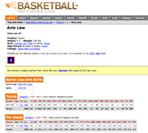
Crawling
Given as input a small set of sample pages from distinct web sites
The system automatically discovers pages containing data about other instances of the conceptual entity exemplified by the input samples
Notes:
50

Slide 51
The crawler, approach
Given a bunch of sample pages
crawl the web sites of the sample pages to gather other pages offering the same type of information
extract a set of keywords that describe the underlying entity
do
launch web searches to find other sources with pages that contain instances of the target entity
analyze the results to filter out irrelevant pages
crawl the new sources to gather new pages
while new pages are found
Notes:
51

Slide 52
Data and Sources Reliability
Redundancy among autonomous and heterogeneous sources implies inconsistencies and conflicts in the integrated data because sources can provide different values for the same property of a given object
A concrete example: on April 21th 2009, the open trade for the Sun Microsystem Inc. stock quote published by the CNN Money, Google Finance, and Yahoo! Finance web sites, was 9.17, 9.15 and 9.15, respectively.

Slide 53
System architecture
Flint
Web
Search
Data Extraction
Data Integration
The Web

Slide 54
System architecture
Flint
Web
search
Extraction
Integration
Probability
The Web

Slide 55
Summary
The exploitation of structure is essential for extracting information from the Web
In the Web world, task automation is needed to get scalability
Interaction of different activities (extraction, search, transformation, integration) is often important

